Slide 1
Data Mining:
Concepts and Techniques
(3rd ed.)
— Chapter 10 —
Jiawei Han, Micheline Kamber, and Jian Pei
University of Illinois at Urbana-Champaign &
Simon Fraser University
©2010 Han, Kamber & Pei. All rights reserved.

Slide 2
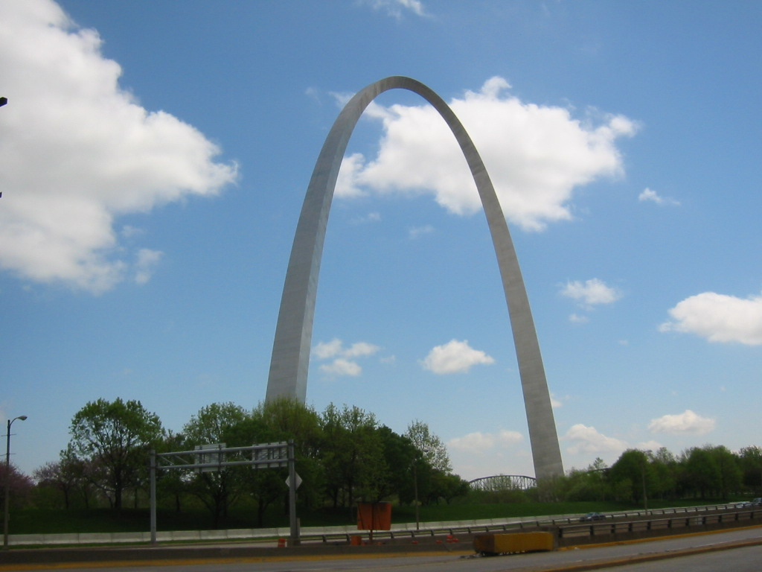

Slide 3
Chapter 10. Cluster Analysis: Basic Concepts and Methods
Cluster Analysis: Basic Concepts
Partitioning Methods
Hierarchical Methods
Density-Based Methods
Grid-Based Methods
+ Clustering High-Dimensional Data (from Chap. 11)
Evaluation of Clustering
Summary

Slide 4
What is Cluster Analysis?
Cluster: A collection of data objects
  similar (or related) to one another within the same group
  dissimilar (or unrelated) to the objects in other groups
Cluster analysis (or clustering, data segmentation, …)
  Finding similarities between data according to the characteristics found in the data and grouping similar data objects into clusters
Unsupervised learning: no predefined classes (i.e., learning by observations vs. learning by examples: supervised)
Typical applications
  As a stand-alone tool to get insight into data distribution
  As a preprocessing step for other algorithms

Slide 5
Clustering for Data Understanding and Applications
Biology: taxonomy of living things: kingdom, phylum, class, order, family, genus and species
Information retrieval: document clustering
Land use: Identification of areas of similar land use in an earth observation database
Marketing: Help marketers discover distinct groups in their customer bases, and then use this knowledge to develop targeted marketing programs
City-planning: Identifying groups of houses according to their house type, value, and geographical location
Earth-quake studies: Observed earth quake epicenters should be clustered along continent faults
Climate: understanding earth climate, find patterns of atmospheric and ocean
Economic Science: market resarch

Slide 6
Clustering as a Preprocessing Tool (Utility)
Summarization:
  Preprocessing for regression, PCA, classification, and association analysis
Compression:
  Image processing: vector quantization
Finding K-nearest Neighbors
  Localizing search to one or a small number of clusters
Outlier detection
  Outliers are often viewed as those “far away” from any cluster

Slide 7
Quality: What Is Good Clustering?
A good clustering method will produce high quality clusters
  high intra-class similarity: cohesive within clusters
  low inter-class similarity: distinctive between clusters
The quality of a clustering method depends on
  the similarity measure used by the method
  its implementation, and
  Its ability to discover some or all of the hidden patterns

Slide 8
Measure the Quality of Clustering
Dissimilarity/Similarity metric
  Similarity is expressed in terms of a distance function, typically metric: d(i, j)
  The definitions of distance functions are usually rather different for interval-scaled, boolean, categorical, ordinal ratio, and vector variables
  Weights should be associated with different variables based on applications and data semantics
Quality of clustering:
  There is usually a separate “quality” function that measures the “goodness” of a cluster.
  It is hard to define “similar enough” or “good enough”
    The answer is typically highly subjective

Slide 9
Considerations for Cluster Analysis
Partitioning criteria
  Single level vs. hierarchical partitioning (often, multi-level hierarchical partitioning is desirable)
Separation of clusters
  Exclusive (e.g., one customer belongs to only one region) vs. non-exclusive (e.g., one document may belong to more than one class)
Similarity measure
  Distance-based (e.g., Euclidian, road network, vector) vs. connectivity-based (e.g., density or contiguity)
Clustering space
  Full space (often when low dimensional) vs. subspaces (often in high-dimensional clustering)

Slide 10
Requirements and Challenges
Scalability
  Clustering all the data instead of only on samples
Ability to deal with different types of attributes
  Numerical, binary, categorical, ordinal, linked, and mixture of these
Constraint-based clustering
    User may give inputs on constraints
    Use domain knowledge to determine input parameters
Interpretability and usability
Others
  Discovery of clusters with arbitrary shape
  Ability to deal with noisy data
  Incremental clustering and insensitivity to input order
  High dimensionality

Slide 11
Major Clustering Approaches (I)
Partitioning approach:
  Construct various partitions and then evaluate them by some criterion, e.g., minimizing the sum of square errors
  Typical methods: k-means, k-medoids, CLARANS
Hierarchical approach:
  Create a hierarchical decomposition of the set of data (or objects) using some criterion
  Typical methods: Diana, Agnes, BIRCH, CAMELEON
Density-based approach:
  Based on connectivity and density functions
  Typical methods: DBSACN, OPTICS, DenClue
Grid-based approach:
  based on a multiple-level granularity structure
  Typical methods: STING, WaveCluster, CLIQUE

Slide 12
Major Clustering Approaches (II)
Model-based:
  A model is hypothesized for each of the clusters and tries to find the best fit of that model to each other
  Typical methods: EM, SOM, COBWEB
Frequent pattern-based:
  Based on the analysis of frequent patterns
  Typical methods: p-Cluster
User-guided or constraint-based:
  Clustering by considering user-specified or application-specific constraints
  Typical methods: COD (obstacles), constrained clustering
Link-based clustering:
  Objects are often linked together in various ways
  Massive links can be used to cluster objects: SimRank, LinkClus

Slide 13
Chapter 10. Cluster Analysis: Basic Concepts and Methods
Cluster Analysis: Basic Concepts
Partitioning Methods
Hierarchical Methods
Density-Based Methods
Grid-Based Methods
+ Clustering High-Dimensional Data (from Chap. 11)
Evaluation of Clustering
Summary

Slide 14

Partitioning Algorithms: Basic Concept
Partitioning method: Partitioning a database D of n objects into a set of k clusters, such that the sum of squared distances is minimized (where c_{i} is the centroid or medoid of cluster C_{i})
Given k, find a partition of k clusters that optimizes the chosen partitioning criterion
  Global optimal: exhaustively enumerate all partitions
  Heuristic methods: k-means and k-medoids algorithms
  k-means (MacQueen’67, Lloyd’57/’82): Each cluster is represented by the center of the cluster
  k-medoids or PAM (Partition around medoids) (Kaufman & Rousseeuw’87): Each cluster is represented by one of the objects in the cluster

Slide 15
The K-Means Clustering Method
Given k, the k-means algorithm is implemented in four steps:
  Partition objects into k nonempty subsets
  Compute seed points as the centroids of the clusters of the current partitioning (the centroid is the center, i.e., mean point, of the cluster)
  Assign each object to the cluster with the nearest seed point
  Go back to Step 2, stop when the assignment does not change

Slide 16





An Example of K-Means Clustering
K=2
Arbitrarily partition objects into k groups
Update the cluster centroids
The initial data set
Loop if needed
Reassign objects
Partition objects into k nonempty subsets
Repeat
  Compute centroid (i.e., mean point) for each partition
  Assign each object to the cluster of its nearest centroid
Until no change
Update the cluster centroids

Slide 17
Comments on the K-Means Method
Strength: Efficient: O(tkn), where n is # objects, k is # clusters, and t is # iterations. Normally, k, t << n.
    Comparing: PAM: O(k(n-k)² ), CLARA: O(ks² + k(n-k))
Comment: Often terminates at a local optimal.
Weakness
  Applicable only to objects in a continuous n-dimensional space
    Using the k-modes method for categorical data
    In comparison, k-medoids can be applied to a wide range of data
  Need to specify k, the number of clusters, in advance (there are ways to automatically determine the best k (see Hastie et al., 2009)
  Sensitive to noisy data and outliers
  Not suitable to discover clusters with non-convex shapes

Slide 18

Variations of the K-Means Method
Most of the variants of the k-means which differ in
  Selection of the initial k means
  Dissimilarity calculations
  Strategies to calculate cluster means
Handling categorical data: k-modes
  Replacing means of clusters with modes
  Using new dissimilarity measures to deal with categorical objects
  Using a frequency-based method to update modes of clusters
  A mixture of categorical and numerical data: k-prototype method

Slide 19
What Is the Problem of the K-Means Method?
The k-means algorithm is sensitive to outliers !
  Since an object with an extremely large value may substantially distort the distribution of the data
K-Medoids: Instead of taking the mean value of the object in a cluster as a reference point, medoids can be used, which is the most centrally located object in a cluster
10
10
9
9
8
8
7
7
6
6
5
5
4
4
3
3
2
2
1
1
0
0
1
2
3
4
5
6
7
8
9
10
0
0
1
2
3
4
5
6
7
8
9
10

Slide 20

PAM: A Typical K-Medoids Algorithm
Total Cost = 20
10
9
8
Arbitrary choose k object as initial medoids
Assign each remaining object to nearest medoids
7
6
5
4
3
2
1
0
0
1
2
3
4
5
6
7
8
9
10
K=2
Randomly select a nonmedoid object,O_{ramdom}
Total Cost = 26
Do loop
Until no change
10
10
9
Compute total cost of swapping
9
Swapping O and O_{ramdom}
If quality is improved.
8
8
7
7
6
6
5
5
4
4
3
3
2
2
1
1
0
0
1
2
3
4
5
6
7
8
9
10
0
0
1
2
3
4
5
6
7
8
9
10

Slide 21
The K-Medoid Clustering Method
K-Medoids Clustering: Find representative objects (medoids) in clusters
  PAM (Partitioning Around Medoids, Kaufmann & Rousseeuw 1987)
    Starts from an initial set of medoids and iteratively replaces one of the medoids by one of the non-medoids if it improves the total distance of the resulting clustering
    PAM works effectively for small data sets, but does not scale well for large data sets (due to the computational complexity)
Efficiency improvement on PAM
  CLARA (Kaufmann & Rousseeuw, 1990): PAM on samples
  CLARANS (Ng & Han, 1994): Randomized re-sampling

Slide 22
Chapter 10. Cluster Analysis: Basic Concepts and Methods
Cluster Analysis: Basic Concepts
Partitioning Methods
Hierarchical Methods
Density-Based Methods
Grid-Based Methods
+ Clustering High-Dimensional Data (from Chap. 11)
Evaluation of Clustering
Summary

Slide 23
Hierarchical Clustering
Use distance matrix as clustering criteria. This method does not require the number of clusters k as an input, but needs a termination condition
Step 0
Step 1
Step 2
Step 3
Step 4
agglomerative
(AGNES)
a
a b
b
a b c d e
c
c d e
d
d e
e
divisive
(DIANA)
Step 4
Step 3
Step 2
Step 1
Step 0

Slide 24

AGNES (Agglomerative Nesting)
Introduced in Kaufmann and Rousseeuw (1990)
Implemented in statistical packages, e.g., Splus
Use the single-link method and the dissimilarity matrix
Merge nodes that have the least dissimilarity
Go on in a non-descending fashion
Eventually all nodes belong to the same cluster

Slide 25
Dendrogram: Shows How Clusters are Merged
  Decompose data objects into a several levels of nested partitioning (tree of clusters), called a dendrogram
  A clustering of the data objects is obtained by cutting the dendrogram at the desired level, then each connected component forms a cluster

Slide 26
DIANA (Divisive Analysis)
Introduced in Kaufmann and Rousseeuw (1990)
Implemented in statistical analysis packages, e.g., Splus
Inverse order of AGNES
Eventually each node forms a cluster on its own

Slide 27
Distance between Clusters
X
X
Single link: smallest distance between an element in one cluster and an element in the other, i.e., dist(K_{i}, K_{j}) = min(t_{ip}, t_{jq})
Complete link: largest distance between an element in one cluster and an element in the other, i.e., dist(K_{i}, K_{j}) = max(t_{ip}, t_{jq})
Average: avg distance between an element in one cluster and an element in the other, i.e., dist(K_{i}, K_{j}) = avg(t_{ip}, t_{jq})
Centroid: distance between the centroids of two clusters, i.e., dist(K_{i}, K_{j}) = dist(C_{i}, C_{j})
Medoid: distance between the medoids of two clusters, i.e., dist(K_{i}, K_{j}) = dist(M_{i}, M_{j})
  Medoid: a chosen, centrally located object in the cluster

Slide 28



Centroid, Radius and Diameter of a Cluster (for numerical data sets)
Centroid: the “middle” of a cluster
Radius: square root of average distance from any point of the cluster to its centroid
Diameter: square root of average mean squared distance between all pairs of points in the cluster

Slide 29
Extensions to Hierarchical Clustering
Major weakness of agglomerative clustering methods
  Can never undo what was done previously
  Do not scale well: time complexity of at least O(n²), where n is the number of total objects
Integration of hierarchical & distance-based clustering
  BIRCH (1996): uses CF-tree and incrementally adjusts the quality of sub-clusters
  CHAMELEON (1999): hierarchical clustering using dynamic modeling

Slide 30
BIRCH (Balanced Iterative Reducing and Clustering Using Hierarchies)
Zhang, Ramakrishnan & Livny, SIGMOD’96
Incrementally construct a CF (Clustering Feature) tree, a hierarchical data structure for multiphase clustering
  Phase 1: scan DB to build an initial in-memory CF tree (a multi-level compression of the data that tries to preserve the inherent clustering structure of the data)
  Phase 2: use an arbitrary clustering algorithm to cluster the leaf nodes of the CF-tree
Scales linearly: finds a good clustering with a single scan and improves the quality with a few additional scans
Weakness: handles only numeric data, and sensitive to the order of the data record

Slide 31
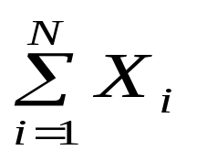
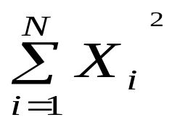
Clustering Feature Vector in BIRCH
Clustering Feature (CF): CF = (N, LS, SS)
N: Number of data points
LS: linear sum of N points:
SS: square sum of N points
CF = (5, (16,30),(54,190))
(3,4)
(2,6)
(4,5)
(4,7)
(3,8)

Slide 32

CF-Tree in BIRCH
Clustering feature:
  Summary of the statistics for a given subcluster: the 0-th, 1st, and 2nd moments of the subcluster from the statistical point of view
  Registers crucial measurements for computing cluster and utilizes storage efficiently
A CF tree is a height-balanced tree that stores the clustering features for a hierarchical clustering
  A nonleaf node in a tree has descendants or “children”
  The nonleaf nodes store sums of the CFs of their children
A CF tree has two parameters
  Branching factor: max # of children
  Threshold: max diameter of sub-clusters stored at the leaf nodes

Slide 33
The CF Tree Structure
Root
B = 7
L = 6
CF₁
CF₂
CF₃
CF₆
child₁
child₂
child₃
child₆
Non-leaf node
CF₁
CF₂
CF₃
CF₅
child₁
child₂
child₃
child₅
Leaf node
Leaf node
prev
CF₁
CF₂
CF₆
next
prev
CF₁
CF₂
CF₄
next

Slide 34
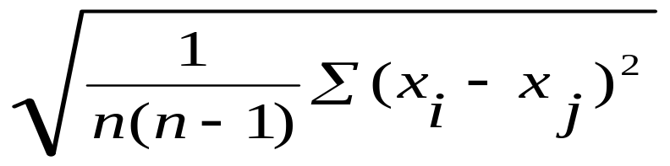
The Birch Algorithm
Cluster Diameter
For each point in the input
  Find closest leaf entry
  Add point to leaf entry and update CF
  If entry diameter > max_diameter, then split leaf, and possibly parents
Algorithm is O(n)
Concerns
  Sensitive to insertion order of data points
  Since we fix the size of leaf nodes, so clusters may not be so natural
  Clusters tend to be spherical given the radius and diameter measures

Slide 35
CHAMELEON: Hierarchical Clustering Using Dynamic Modeling (1999)
CHAMELEON: G. Karypis, E. H. Han, and V. Kumar, 1999
Measures the similarity based on a dynamic model
  Two clusters are merged only if the interconnectivity and closeness (proximity) between two clusters are high relative to the internal interconnectivity of the clusters and closeness of items within the clusters
Graph-based, and a two-phase algorithm
  Use a graph-partitioning algorithm: cluster objects into a large number of relatively small sub-clusters
  Use an agglomerative hierarchical clustering algorithm: find the genuine clusters by repeatedly combining these sub-clusters

Slide 36
Overall Framework of CHAMELEON
Construct (K-NN)
Sparse Graph
Partition the Graph
Data Set
K-NN Graph
  P and q are connected if q is among the top k closest neighbors of p
Merge Partition
Relative interconnectivity: connectivity of c₁ and c₂ over internal connectivity
Relative closeness: closeness of c₁ and c₂ over internal closeness
Final Clusters

Slide 37

CHAMELEON (Clustering Complex Objects)

Slide 38
Probabilistic Hierarchical Clustering
Algorithmic hierarchical clustering
  Nontrivial to choose a good distance measure
  Hard to handle missing attribute values
  Optimization goal not clear: heuristic, local search
Probabilistic hierarchical clustering
  Use probabilistic models to measure distances between clusters
  Generative model: Regard the set of data objects to be clustered as a sample of the underlying data generation mechanism to be analyzed
  Easy to understand, same efficiency as algorithmic agglomerative clustering method, can handle partially observed data
In practice, assume the generative models adopt common distributions functions, e.g., Gaussian distribution or Bernoulli distribution, governed by parameters

Slide 39
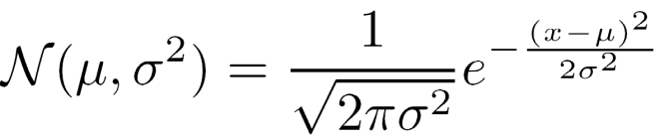
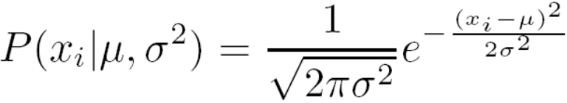

Generative Model
Given a set of 1-D points X = {x₁, …, x_{n}} for clustering analysis & assuming they are generated by a Gaussian distribution:
The probability that a point x_{i} ∈ X is generated by the model
The likelihood that X is generated by the model:
The task of learning the generative model: find the parameters μ and σ² such that
the maximum likelihood

Slide 40

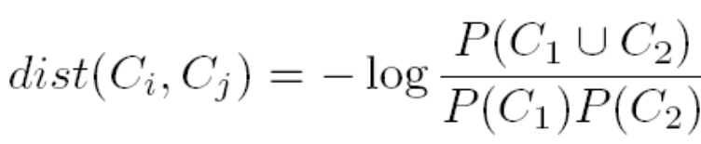
A Probabilistic Hierarchical Clustering Algorithm
For a set of objects partitioned into m clusters C₁, . . . ,C_{m}, the quality can be measured by,
  where P() is the maximum likelihood
Distance between clusters C₁ and C₂:
Algorithm: Progressively merge points and clusters
  Input: D = {o₁, ..., o_{n}}: a data set containing n objects
  Output: A hierarchy of clusters
  Method
    Create a cluster for each object C_{i} = {o_{i}}, 1 ≤ i ≤ n;
    For i = 1 to n {
      Find pair of clusters C_{i} and C_{j} such that
        C_{i},C_{j} = argmax_{i ≠ j} {log (P(C_{i}∪C_{j} )/(P(C_{i})P(C_{j} ))};
      If log (P(C_{i}∪C_{j} )/(P(C_{i})P(C_{j} )) > 0 then merge C_{i} and C_{j} }

Slide 41
Chapter 10. Cluster Analysis: Basic Concepts and Methods
Cluster Analysis: Basic Concepts
Partitioning Methods
Hierarchical Methods
Density-Based Methods
Grid-Based Methods
+ Clustering High-Dimensional Data (from Chap. 11)
Evaluation of Clustering
Summary

Slide 42
Density-Based Clustering Methods
Clustering based on density (local cluster criterion), such as density-connected points
Major features:
  Discover clusters of arbitrary shape
  Handle noise
  One scan
  Need density parameters as termination condition
Several interesting studies:
  DBSCAN: Ester, et al. (KDD’96)
  OPTICS: Ankerst, et al (SIGMOD’99).
  DENCLUE: Hinneburg & D. Keim (KDD’98)
  CLIQUE: Agrawal, et al. (SIGMOD’98) (more grid-based)

Slide 43
Density-Based Clustering: Basic Concepts
Two parameters:
  Eps: Maximum radius of the neighbourhood
  MinPts: Minimum number of points in an Eps-neighbourhood of that point
N_{Eps}(p): {q belongs to D | dist(p,q) ≤ Eps}
Directly density-reachable: A point p is directly density-reachable from a point q w.r.t. Eps, MinPts if
  p belongs to N_{Eps}(q)
  core point condition:
  |N_{Eps} (q)| ≥ MinPts
p
MinPts = 5
Eps = 1 cm
q

Slide 44
Density-Reachable and Density-Connected
Density-reachable:
  A point p is density-reachable from a point q w.r.t. Eps, MinPts if there is a chain of points p₁, …, p_{n}, p₁ = q, p_{n} = p such that p_{i+1} is directly density-reachable from p_{i}
Density-connected
  A point p is density-connected to a point q w.r.t. Eps, MinPts if there is a point o such that both, p and q are density-reachable from o w.r.t. Eps and MinPts
p
p₁
q
p
q
o

Slide 45
DBSCAN: Density-Based Spatial Clustering of Applications with Noise
Relies on a density-based notion of cluster: A cluster is defined as a maximal set of density-connected points
Discovers clusters of arbitrary shape in spatial databases with noise
Outlier
Border
Eps = 1cm
MinPts = 5
Core

Slide 46
DBSCAN: The Algorithm
Arbitrary select a point p
Retrieve all points density-reachable from p w.r.t. Eps and MinPts
If p is a core point, a cluster is formed
If p is a border point, no points are density-reachable from p and DBSCAN visits the next point of the database
Continue the process until all of the points have been processed

Slide 47



DBSCAN: Sensitive to Parameters

Slide 48
OPTICS: A Cluster-Ordering Method (1999)
OPTICS: Ordering Points To Identify the Clustering Structure
  Ankerst, Breunig, Kriegel, and Sander (SIGMOD’99)
  Produces a special order of the database wrt its density-based clustering structure
  This cluster-ordering contains info equiv to the density-based clusterings corresponding to a broad range of parameter settings
  Good for both automatic and interactive cluster analysis, including finding intrinsic clustering structure
  Can be represented graphically or using visualization techniques

Slide 49
OPTICS: Some Extension from DBSCAN
Index-based:
    k = number of dimensions
    N = 20
    p = 75%
    M = N(1-p) = 5
  Complexity: O(NlogN)
Core Distance:
  min eps s.t. point is core
Reachability Distance
D
p1
o
p2
o
Max (core-distance (o), d (o, p))
r(p1, o) = 2.8cm. r(p2,o) = 4cm
MinPts = 5
ε = 3 cm

Slide 50


Reachability-distance
undefined
‘
Cluster-order
of the objects

Slide 51




Density-Based Clustering: OPTICS & Its Applications

Slide 52



DENCLUE: Using Statistical Density Functions
DENsity-based CLUstEring by Hinneburg & Keim (KDD’98)
Using statistical density functions:
Major features
  Solid mathematical foundation
  Good for data sets with large amounts of noise
  Allows a compact mathematical description of arbitrarily shaped clusters in high-dimensional data sets
  Significant faster than existing algorithm (e.g., DBSCAN)
  But needs a large number of parameters
total influence on x
influence of y on x
gradient of x in the direction of x_{i}

Slide 53
Denclue: Technical Essence
Uses grid cells but only keeps information about grid cells that do actually contain data points and manages these cells in a tree-based access structure
Influence function: describes the impact of a data point within its neighborhood
Overall density of the data space can be calculated as the sum of the influence function of all data points
Clusters can be determined mathematically by identifying density attractors
Density attractors are local maximal of the overall density function
Center defined clusters: assign to each density attractor the points density attracted to it
Arbitrary shaped cluster: merge density attractors that are connected through paths of high density (> threshold)

Slide 54



Density Attractor

Slide 55

Center-Defined and Arbitrary

Slide 56
Chapter 10. Cluster Analysis: Basic Concepts and Methods
Cluster Analysis: Basic Concepts
Partitioning Methods
Hierarchical Methods
Density-Based Methods
Grid-Based Methods
+ Clustering High-Dimensional Data (from Chap. 11)
Evaluation of Clustering
Summary

Slide 57
Grid-Based Clustering Method
Using multi-resolution grid data structure
Several interesting methods
  STING (a STatistical INformation Grid approach) by Wang, Yang and Muntz (1997)
  WaveCluster by Sheikholeslami, Chatterjee, and Zhang (VLDB’98)
    A multi-resolution clustering approach using wavelet method
  CLIQUE: Agrawal, et al. (SIGMOD’98)
    Both grid-based and subspace clustering

Slide 58

STING: A Statistical Information Grid Approach
Wang, Yang and Muntz (VLDB’97)
The spatial area is divided into rectangular cells
There are several levels of cells corresponding to different levels of resolution

Slide 59
The STING Clustering Method
Each cell at a high level is partitioned into a number of smaller cells in the next lower level
Statistical info of each cell is calculated and stored beforehand and is used to answer queries
Parameters of higher level cells can be easily calculated from parameters of lower level cell
  count, mean, s, min, max
  type of distribution—normal, uniform, etc.
Use a top-down approach to answer spatial data queries
Start from a pre-selected layer—typically with a small number of cells
For each cell in the current level compute the confidence interval

Slide 60
STING Algorithm and Its Analysis
Remove the irrelevant cells from further consideration
When finish examining the current layer, proceed to the next lower level
Repeat this process until the bottom layer is reached
Advantages:
  Query-independent, easy to parallelize, incremental update
  O(K), where K is the number of grid cells at the lowest level
Disadvantages:
  All the cluster boundaries are either horizontal or vertical, and no diagonal boundary is detected

Slide 61
CLIQUE (Clustering In QUEst)
Agrawal, Gehrke, Gunopulos, Raghavan (SIGMOD’98)
Automatically identifying subspaces of a high dimensional data space that allow better clustering than original space
CLIQUE can be considered as both density-based and grid-based
  It partitions each dimension into the same number of equal length interval
  It partitions an m-dimensional data space into non-overlapping rectangular units
  A unit is dense if the fraction of total data points contained in the unit exceeds the input model parameter
  A cluster is a maximal set of connected dense units within a subspace

Slide 62
CLIQUE: The Major Steps
Partition the data space and find the number of points that lie inside each cell of the partition.
Identify the subspaces that contain clusters using the Apriori principle
Identify clusters
  Determine dense units in all subspaces of interests
  Determine connected dense units in all subspaces of interests.
Generate minimal description for the clusters
  Determine maximal regions that cover a cluster of connected dense units for each cluster
  Determination of minimal cover for each cluster

Slide 63
Salary (10,000)
Vacation(week)
7
7
6
6
5
5
4
4
3
3
2
2
1
1
0
age
0
age
20
30
40
50
60
20
30
40
50
60
τ = 3
Vacation
Salary
30
50
age

Slide 64
Strength and Weakness of CLIQUE
Strength
  automatically finds subspaces of the highest dimensionality such that high density clusters exist in those subspaces
  insensitive to the order of records in input and does not presume some canonical data distribution
  scales linearly with the size of input and has good scalability as the number of dimensions in the data increases
Weakness
  The accuracy of the clustering result may be degraded at the expense of simplicity of the method

Slide 65
Chapter 10. Cluster Analysis: Basic Concepts and Methods
Cluster Analysis: Basic Concepts
Partitioning Methods
Hierarchical Methods
Density-Based Methods
Grid-Based Methods
+ Clustering High-Dimensional Data (from Chap. 11)
Evaluation of Clustering
Summary

Slide 66
Clustering High-Dimensional Data
Clustering high-dimensional data
  Many applications: text documents, DNA micro-array data
  Major challenges:
    Many irrelevant dimensions may mask clusters
    Distance measure becomes meaningless—due to equi-distance
    Clusters may exist only in some subspaces
Methods
  Feature transformation: only effective if most dimensions are relevant
    PCA & SVD useful only when features are highly correlated/redundant
  Feature selection: wrapper or filter approaches
    useful to find a subspace where the data have nice clusters
  Subspace-clustering: find clusters in all the possible subspaces
    CLIQUE, ProClus, and frequent pattern-based clustering

Slide 67
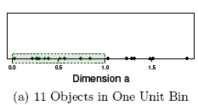
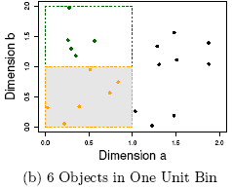
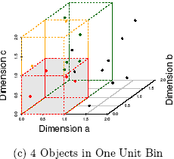
The Curse of Dimensionality
(graphs adapted from Parsons et al. KDD Explorations 2004)
Data in only one dimension is relatively packed
Adding a dimension “stretch” the points across that dimension, making them further apart
Adding more dimensions will make the points further apart—high dimensional data is extremely sparse
Distance measure becomes meaningless—due to equi-distance

Slide 68
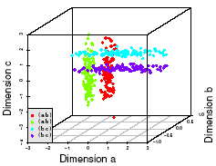
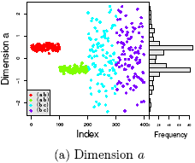
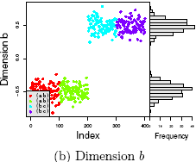
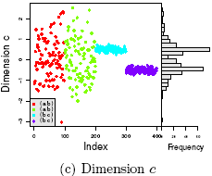
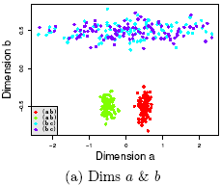
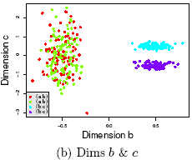
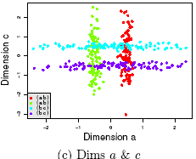
Why Subspace Clustering?
(adapted from Parsons et al. SIGKDD Explorations 2004)
Clusters may exist only in some subspaces
Subspace-clustering: find clusters in all the subspaces

Slide 69
Frequent Pattern-Based Approach
Clustering high-dimensional space (e.g., clustering text documents, microarray data)
  Projected subspace-clustering: which dimensions to be projected on?
    CLIQUE, ProClus
  Feature extraction: costly and may not be effective?
  Using frequent patterns as “features”
Clustering by pattern similarity in micro-array data (pClustering) [H. Wang, W. Wang, J. Yang, and P. S. Yu. Clustering by pattern similarity in large data sets, SIGMOD’02]

Slide 70
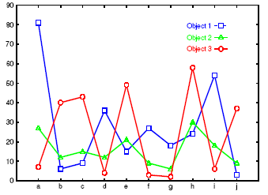
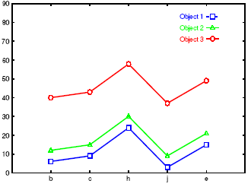
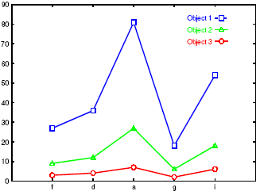
Clustering by Pattern Similarity (p-Clustering)
Left figure: Micro-array “raw” data shows 3 genes and their values in a multi-D space: Difficult to find their patterns
Right two: Some subsets of dimensions form nice shift and scaling patterns
No globally defined similarity/distance measure
Clusters may not be exclusive
  An object can appear in multiple clusters

Slide 71

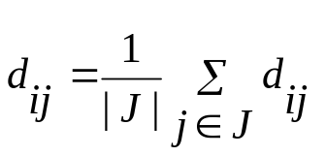
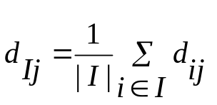
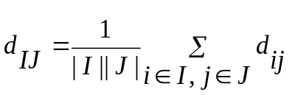
Why p-Clustering?
Microarray data analysis may need to
  Clustering on thousands of dimensions (attributes)
  Discovery of both shift and scaling patterns
Clustering with Euclidean distance measure? — cannot find shift patterns
Clustering on derived attribute A_{ij} = a_{i} – a_{j}? — introduces N(N-1) dimensions
Bi-cluster (Y. Cheng and G. Church. Biclustering of expression data. ISMB’00) using transformed mean-squared residue score matrix (I, J)
  Where
  A submatrix is a δ-cluster if H(I, J) ≤ δ for some δ > 0
Problems with bi-cluster
  No downward closure property
  Due to averaging, it may contain outliers but still within δ-threshold

Slide 72
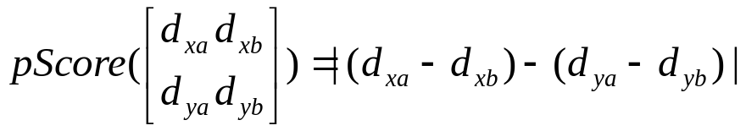
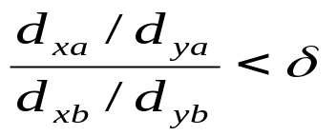
p-Clustering: Clustering by Pattern Similarity
P-score: the similarity between 2 objects r_{x}, r_{y} on 2 attributes a_{u}, a_{v}
δ-pCluster: If for any 2 by 2 matrix X, pScore(X) ≤ δ (δ > 0)
Properties of δ-pCluster
  Downward closure
  Clusters are more homogeneous than bi-cluster (thus the name: pair-wise Cluster)
MaPle (Pei et al. 2003): Efficient mining of maximum p-clusters
For scaling patterns, taking logarithmic on will lead to the pScore form

Slide 73
Chapter 10. Cluster Analysis: Basic Concepts and Methods
Cluster Analysis: Basic Concepts
Partitioning Methods
Hierarchical Methods
Density-Based Methods
Grid-Based Methods
+ Clustering High-Dimensional Data (from Chap. 11)
Evaluation of Clustering
Summary

Slide 74

Assessing Clustering Tendency
Assess if non-random structure exists in the data by measuring the probability that the data is generated by a uniform data distribution
Test spatial randomness by statistic test: Hopkins Static
  Given a dataset D regarded as a sample of a random variable o, determine how far away o is from being uniformly distributed in the data space
  Sample n points, p₁, …, p_{n}, uniformly from D. For each p_{i}, find its nearest neighbor in D: x_{i} = min{dist (p_{i}, v)} where v in D
  Sample n points, q₁, …, q_{n}, uniformly from D. For each q_{i}, find its nearest neighbor in D – {q_{i}}: y_{i} = min{dist (q_{i}, v)} where v in D and v ≠ q_{i}
  Calculate the Hopkins Statistic:
  If D is uniformly distributed, ∑ x_{i} and ∑ y_{i} will be close to each other and H is close to 0.5. If D is highly skewed, H is close to 0

Slide 75
Determine the Number of Clusters
Empirical method
  # of clusters ≈√n/2 for a dataset of n points
Elbow method
  Use the turning point in the curve of sum of within cluster variance w.r.t the # of clusters
Cross validation method
  Divide a given data set into m parts
  Use m – 1 parts to obtain a clustering model
  Use the remaining part to test the quality of the clustering
    E.g., For each point in the test set, find the closest centroid, and use the sum of squared distance between all points in the test set and the closest centroids to measure how well the model fits the test set
  For any k > 0, repeat it m times, compare the overall quality measure w.r.t. different k’s, and find # of clusters that fits the data the best

Slide 76
Measuring Clustering Quality
Two methods: extrinsic vs. intrinsic
Extrinsic: supervised, i.e., the ground truth is available
  Compare a clustering against the ground truth using certain clustering quality measure
  Ex. BCubed precision and recall metrics
Intrinsic: unsupervised, i.e., the ground truth is unavailable
  Evaluate the goodness of a clustering by considering how well the clusters are separated, and how compact the clusters are
  Ex. Silhouette coefficient

Slide 77
Measuring Clustering Quality: Extrinsic Methods
Clustering quality measure: Q(C, C_{g}), for a clustering C given the ground truth C_{g}.
Q is good if it satisfies the following 4 essential criteria
  Cluster homogeneity: the purer, the better
  Cluster completeness: should assign objects belong to the same category in the ground truth to the same cluster
  Rag bag: putting a heterogeneous object into a pure cluster should be penalized more than putting it into a rag bag (i.e., “miscellaneous” or “other” category)
  Small cluster preservation: splitting a small category into pieces is more harmful than splitting a large category into pieces

Slide 78
Chapter 10. Cluster Analysis: Basic Concepts and Methods
Cluster Analysis: Basic Concepts
Partitioning Methods
Hierarchical Methods
Density-Based Methods
Grid-Based Methods
+ Clustering High-Dimensional Data (from Chap. 11)
Evaluation of Clustering
Summary

Slide 79
Summary
Cluster analysis groups objects based on their similarity and has wide applications
Measure of similarity can be computed for various types of data
Clustering algorithms can be categorized into partitioning methods, hierarchical methods, density-based methods, grid-based methods, and model-based methods
K-means and K-medoids algorithms are popular partitioning-based clustering algorithms
Birch and Chameleon are interesting hierarchical clustering algorithms, and there are also probabilistic hierarchical clustering algorithms
DBSCAN, OPTICS, and DENCLU are interesting density-based algorithms
STING and CLIQUE are grid-based methods, where CLIQUE is also a subspace clustering algorithm
Quality of clustering results can be evaluated in various ways

Slide 80
CS512-Spring 2011: An Introduction
Coverage
  Cluster Analysis: Chapter 11
  Outlier Detection: Chapter 12
  Mining Sequence Data: BK2: Chapter 8
  Mining Graphs Data: BK2: Chapter 9
  Social and Information Network Analysis
    BK2: Chapter 9
    Partial coverage: Mark Newman: “Networks: An Introduction”, Oxford U., 2010
    Scattered coverage: Easley and Kleinberg, “Networks, Crowds, and Markets: Reasoning About a Highly Connected World”, Cambridge U., 2010
    Recent research papers
  Mining Data Streams: BK2: Chapter 8
Requirements
  One research project
  One class presentation (15 minutes)
  Two homeworks (no programming assignment)
  Two midterm exams (no final exam)

Slide 81
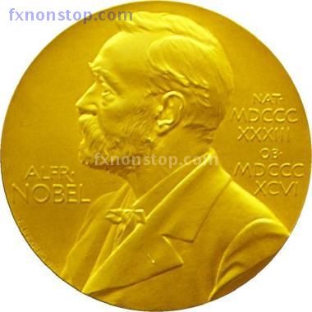
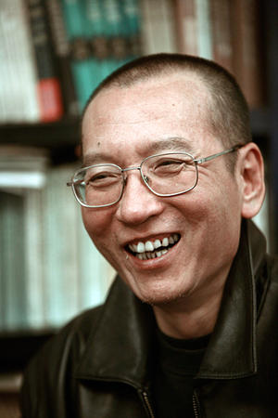
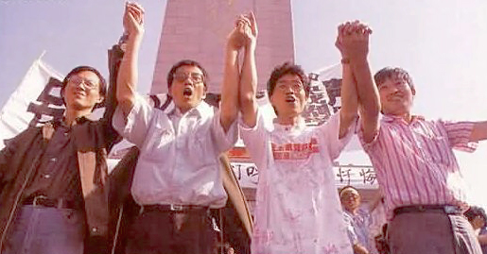
2010 Nobel Peace Prize Winner, Dr. Xiaobo Liu

Slide 82



Slide 83
References (1)
R. Agrawal, J. Gehrke, D. Gunopulos, and P. Raghavan. Automatic subspace clustering of high dimensional data for data mining applications. SIGMOD'98
M. R. Anderberg. Cluster Analysis for Applications. Academic Press, 1973.
M. Ankerst, M. Breunig, H.-P. Kriegel, and J. Sander. Optics: Ordering points to identify the clustering structure, SIGMOD’99.
Beil F., Ester M., Xu X.: "Frequent Term-Based Text Clustering", KDD'02
M. M. Breunig, H.-P. Kriegel, R. Ng, J. Sander. LOF: Identifying Density-Based Local Outliers. SIGMOD 2000.
M. Ester, H.-P. Kriegel, J. Sander, and X. Xu. A density-based algorithm for discovering clusters in large spatial databases. KDD'96.
M. Ester, H.-P. Kriegel, and X. Xu. Knowledge discovery in large spatial databases: Focusing techniques for efficient class identification. SSD'95.
D. Fisher. Knowledge acquisition via incremental conceptual clustering. Machine Learning, 2:139-172, 1987.
D. Gibson, J. Kleinberg, and P. Raghavan. Clustering categorical data: An approach based on dynamic systems. VLDB’98.
V. Ganti, J. Gehrke, R. Ramakrishan. CACTUS Clustering Categorical Data Using Summaries. KDD'99.

Slide 84
References (2)
D. Gibson, J. Kleinberg, and P. Raghavan. Clustering categorical data: An approach based on dynamic systems. In Proc. VLDB’98.
S. Guha, R. Rastogi, and K. Shim. Cure: An efficient clustering algorithm for large databases. SIGMOD'98.
S. Guha, R. Rastogi, and K. Shim. ROCK: A robust clustering algorithm for categorical attributes. In ICDE'99, pp. 512-521, Sydney, Australia, March 1999.
A. Hinneburg, D.l A. Keim: An Efficient Approach to Clustering in Large Multimedia Databases with Noise. KDD’98.
A. K. Jain and R. C. Dubes. Algorithms for Clustering Data. Printice Hall, 1988.
G. Karypis, E.-H. Han, and V. Kumar. CHAMELEON: A Hierarchical Clustering Algorithm Using Dynamic Modeling. COMPUTER, 32(8): 68-75, 1999.
L. Kaufman and P. J. Rousseeuw. Finding Groups in Data: an Introduction to Cluster Analysis. John Wiley & Sons, 1990.
E. Knorr and R. Ng. Algorithms for mining distance-based outliers in large datasets. VLDB’98.

Slide 85
References (3)
G. J. McLachlan and K.E. Bkasford. Mixture Models: Inference and Applications to Clustering. John Wiley and Sons, 1988.
R. Ng and J. Han. Efficient and effective clustering method for spatial data mining. VLDB'94.
L. Parsons, E. Haque and H. Liu, Subspace Clustering for High Dimensional Data: A Review, SIGKDD Explorations, 6(1), June 2004
E. Schikuta. Grid clustering: An efficient hierarchical clustering method for very large data sets. Proc. 1996 Int. Conf. on Pattern Recognition,.
G. Sheikholeslami, S. Chatterjee, and A. Zhang. WaveCluster: A multi-resolution clustering approach for very large spatial databases. VLDB’98.
A. K. H. Tung, J. Han, L. V. S. Lakshmanan, and R. T. Ng. Constraint-Based Clustering in Large Databases, ICDT'01.
A. K. H. Tung, J. Hou, and J. Han. Spatial Clustering in the Presence of Obstacles, ICDE'01
H. Wang, W. Wang, J. Yang, and P.S. Yu. Clustering by pattern similarity in large data sets, SIGMOD’ 02.
W. Wang, Yang, R. Muntz, STING: A Statistical Information grid Approach to Spatial Data Mining, VLDB’97.
T. Zhang, R. Ramakrishnan, and M. Livny. BIRCH : An efficient data clustering method for very large databases. SIGMOD'96.
Xiaoxin Yin, Jiawei Han, and Philip Yu, “LinkClus: Efficient Clustering via Heterogeneous Semantic Links”, in Proc. 2006 Int. Conf. on Very Large Data Bases (VLDB'06), Seoul, Korea, Sept. 2006.

Slide 86
Chapter 10. Cluster Analysis: Basic Concepts and Methods
Cluster Analysis: Basic Concepts
  What Is Cluster Analysis?
  What is Good Clustering? Measuring the Quality of Clustering
  Major categories of clustering methods
Clustering structures
  Calculating Distance between Clusters
Partitioning Methods
  k-Means: A Classical Partitioning Method
  Alternative Methods: k-Medoids, k-Median, and its Variations
Hierarchical Methods
  Agglomerative and Divisive Hierarchical Clustering
  BIRCH: A Hierarchical, Micro-Clustering Approach
  Chameleon: A Hierarchical Clustering Algorithm Using Dynamic Modeling
Density-Based Methods
  DBSCAN and OPTICS: Density-Based Clustering Based on Connected Regions
  DENCLUE: Clustering Based on Density Distribution Functions
Link-Based Cluster Analysis
  SimRank: Exploring Links in Cluster Analysis
  LinkClus: Scalability in Link-Based Cluster Analysis
Grid-Based Methods
  STING: STatistical INformation Grid
  WaveCluster: Clustering Using Wavelet Transformation
  CLIQUE: A Dimension-Growth Subspace Clustering Method
Summary

Slide 87
Slides unused in class

Slide 88
A Typical K-Medoids Algorithm (PAM)
Total Cost = 20
10
9
8
Arbitrary choose k object as initial medoids
Assign each remaining object to nearest medoids
7
6
5
4
3
2
1
0
0
1
2
3
4
5
6
7
8
9
10
K=2
Randomly select a nonmedoid object,O_{ramdom}
Total Cost = 26
Do loop
Until no change
10
10
9
Compute total cost of swapping
9
Swapping O and O_{ramdom}
If quality is improved.
8
8
7
7
6
6
5
5
4
4
3
3
2
2
1
1
0
0
1
2
3
4
5
6
7
8
9
10
0
0
1
2
3
4
5
6
7
8
9
10

Slide 89
PAM (Partitioning Around Medoids) (1987)
PAM (Kaufman and Rousseeuw, 1987), built in Splus
Use real object to represent the cluster
  Select k representative objects arbitrarily
  For each pair of non-selected object h and selected object i, calculate the total swapping cost TC_{ih}
  For each pair of i and h,
    If TC_{ih} < 0, i is replaced by h
    Then assign each non-selected object to the most similar representative object
  repeat steps 2-3 until there is no change

Slide 90
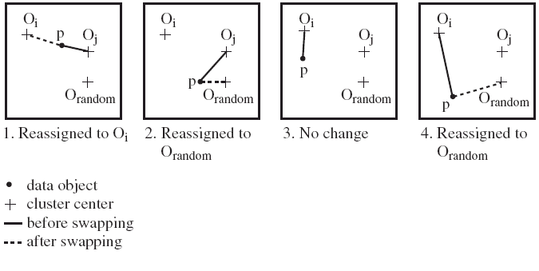
PAM Clustering: Finding the Best Cluster Center
Case 1: p currently belongs to o_{j}. If o_{j} is replaced by o_{random} as a representative object and p is the closest to one of the other representative object o_{i}, then p is reassigned to o_{i}

Slide 91
What Is the Problem with PAM?
Pam is more robust than k-means in the presence of noise and outliers because a medoid is less influenced by outliers or other extreme values than a mean
Pam works efficiently for small data sets but does not scale well for large data sets.
  O(k(n-k)² ) for each iteration
where n is # of data,k is # of clusters
Sampling-based method
CLARA(Clustering LARge Applications)

Slide 92
CLARA (Clustering Large Applications) (1990)
CLARA (Kaufmann and Rousseeuw in 1990)
  Built in statistical analysis packages, such as SPlus
  It draws multiple samples of the data set, applies PAM on each sample, and gives the best clustering as the output
Strength: deals with larger data sets than PAM
Weakness:
  Efficiency depends on the sample size
  A good clustering based on samples will not necessarily represent a good clustering of the whole data set if the sample is biased

Slide 93
CLARANS (“Randomized” CLARA) (1994)
CLARANS (A Clustering Algorithm based on Randomized Search) (Ng and Han’94)
  Draws sample of neighbors dynamically
  The clustering process can be presented as searching a graph where every node is a potential solution, that is, a set of k medoids
  If the local optimum is found, it starts with new randomly selected node in search for a new local optimum
Advantages: More efficient and scalable than both PAM and CLARA
Further improvement: Focusing techniques and spatial access structures (Ester et al.’95)

Slide 94
ROCK: Clustering Categorical Data
ROCK: RObust Clustering using linKs
  S. Guha, R. Rastogi & K. Shim, ICDE’99
Major ideas
  Use links to measure similarity/proximity
  Not distance-based
Algorithm: sampling-based clustering
  Draw random sample
  Cluster with links
  Label data in disk
Experiments
  Congressional voting, mushroom data

Slide 95

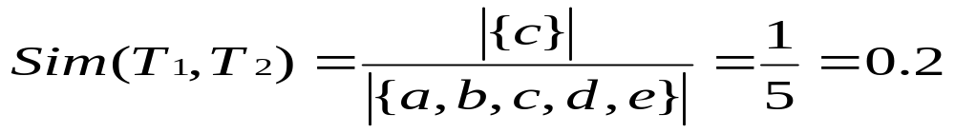
Similarity Measure in ROCK
Traditional measures for categorical data may not work well, e.g., Jaccard coefficient
Example: Two groups (clusters) of transactions
  C₁. <a, b, c, d, e>: {a, b, c}, {a, b, d}, {a, b, e}, {a, c, d}, {a, c, e}, {a, d, e}, {b, c, d}, {b, c, e}, {b, d, e}, {c, d, e}
  C₂. <a, b, f, g>: {a, b, f}, {a, b, g}, {a, f, g}, {b, f, g}
Jaccard co-efficient may lead to wrong clustering result
  C₁: 0.2 ({a, b, c}, {b, d, e}} to 0.5 ({a, b, c}, {a, b, d})
  C₁ & C₂: could be as high as 0.5 ({a, b, c}, {a, b, f})
Jaccard co-efficient-based similarity function:
  Ex. Let T₁ = {a, b, c}, T₂ = {c, d, e}

Slide 96
Link Measure in ROCK
Clusters
  C₁:<a, b, c, d, e>: {a, b, c}, {a, b, d}, {a, b, e}, {a, c, d}, {a, c, e}, {a, d, e}, {b, c, d}, {b, c, e}, {b, d, e}, {c, d, e}
  C₂: <a, b, f, g>: {a, b, f}, {a, b, g}, {a, f, g}, {b, f, g}
Neighbors
  Two transactions are neighbors if sim(T₁,T₂) > threshold
  Let T₁ = {a, b, c}, T₂ = {c, d, e}, T₃ = {a, b, f}
    T₁ connected to: {a,b,d}, {a,b,e}, {a,c,d}, {a,c,e}, {b,c,d}, {b,c,e}, {a,b,f}, {a,b,g}
    T₂ connected to: {a,c,d}, {a,c,e}, {a,d,e}, {b,c,e}, {b,d,e}, {b,c,d}
    T₃ connected to: {a,b,c}, {a,b,d}, {a,b,e}, {a,b,g}, {a,f,g}, {b,f,g}
Link Similarity
  Link similarity between two transactions is the # of common neighbors
  link(T_{1,} T₂) = 4, since they have 4 common neighbors
    {a, c, d}, {a, c, e}, {b, c, d}, {b, c, e}
  link(T_{1,} T₃) = 3, since they have 3 common neighbors
    {a, b, d}, {a, b, e}, {a, b, g}

Slide 97
Rock Algorithm
Method
  Compute similarity matrix
    Use link similarity
  Run agglomerative hierarchical clustering
  When the data set is big
    Get sample of transactions
    Cluster sample
Problems:
  Guarantee cluster interconnectivity
    any two transactions in a cluster are very well connected
  Ignores information about closeness of two clusters
    two separate clusters may still be quite connected

Slide 98
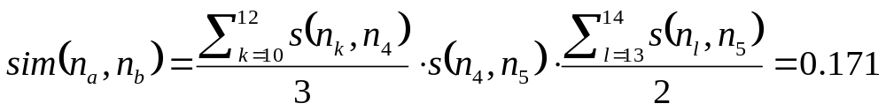
Aggregation-Based Similarity Computation
0.2
ST₂
4
5
0.9
1.0
0.8
0.9
1.0
10
11
12
13
14
ST₁
a
b
For each node n_{k} ∈ {n₁₀, n₁₁, n₁₂} and n_{l} ∈ {n₁₃, n₁₄}, their path-based similarity sim_{p}(n_{k}, n_{l}) = s(n_{k}, n₄)·s(n₄, n₅)·s(n₅, n_{l}).
takes O(3+2) time
After aggregation, we reduce quadratic time computation to linear time computation.

Slide 99
Computing Similarity with Aggregation
Average similarity
and total weight
a:(0.9,3)
b:(0.95,2)
0.2
4
5
sim(n_{a}, n_{b}) can be computed from aggregated similarities
10
11
12
13
14
a
b
sim(n_{a}, n_{b}) = avg_sim(n_{a},n₄) x s(n₄, n₅) x avg_sim(n_{b},n₅)
= 0.9 x 0.2 x 0.95 = 0.171
To compute sim(n_{a},n_{b}):
Find all pairs of sibling nodes n_{i} and n_{j}, so that n_{a} linked with n_{i} and n_{b} with n_{j}.
Calculate similarity (and weight) between n_{a} and n_{b} w.r.t. n_{i} and n_{j}.
Calculate weighted average similarity between n_{a} and n_{b} w.r.t. all such pairs.

Slide 100
Chapter 10. Cluster Analysis: Basic Concepts and Methods
Cluster Analysis: Basic Concepts
Overview of Clustering Methods
Partitioning Methods
Hierarchical Methods
Density-Based Methods
Grid-Based Methods
Summary

Slide 101
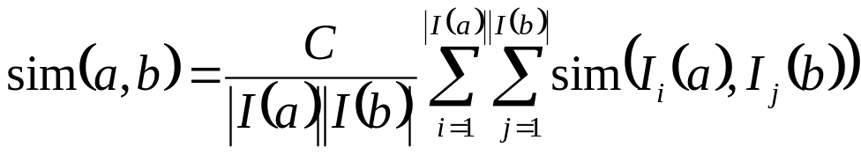
Link-Based Clustering: Calculate Similarities Based On Links
Authors
Proceedings
Conferences
The similarity between two objects x and y is defined as the average similarity between objects linked with x and those with y:
Issue: Expensive to compute:
  For a dataset of N objects and M links, it takes O(N²) space and O(M²) time to compute all similarities.
Tom
sigmod03
sigmod04
sigmod
Mike
sigmod05
vldb03
Cathy
vldb04
vldb
John
vldb05
aaai04
aaai
Mary
aaai05
Jeh & Widom, KDD’2002: SimRank
Two objects are similar if they are linked with the same or similar objects

Slide 102
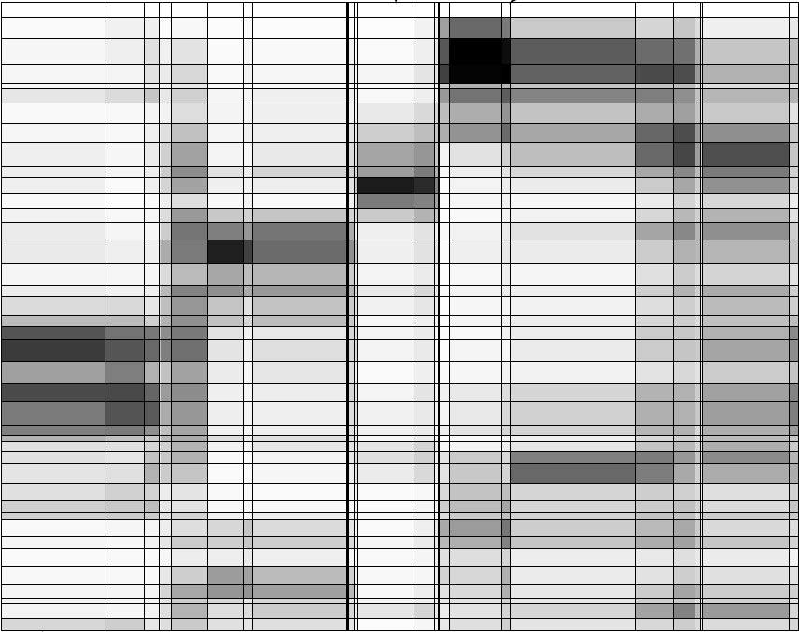
Observation 1: Hierarchical Structures
Hierarchical structures often exist naturally among objects (e.g., taxonomy of animals)
Relationships between articles and words (Chakrabarti, Papadimitriou, Modha, Faloutsos, 2004)
A hierarchical structure of products in Walmart
All
grocery
electronics
apparel
Articles
TV
DVD
camera
Words

Slide 103
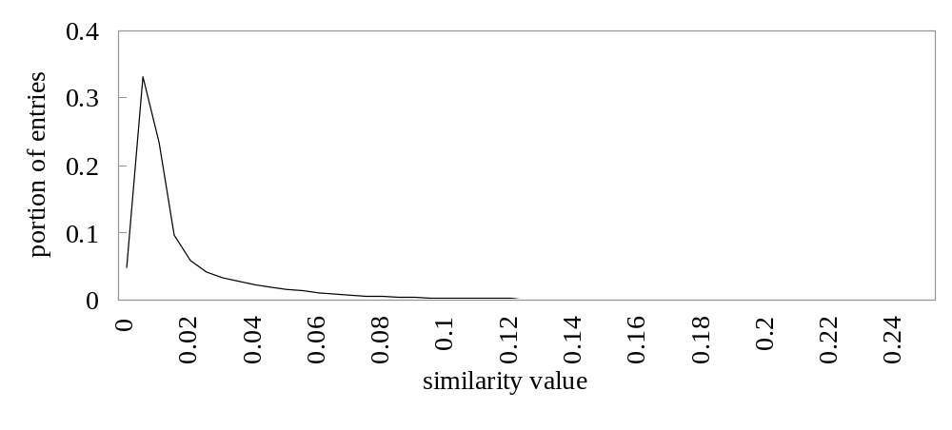
Observation 2: Distribution of Similarity
Distribution of SimRank similarities among DBLP authors
Power law distribution exists in similarities
  56% of similarity entries are in [0.005, 0.015]
  1.4% of similarity entries are larger than 0.1
  Can we design a data structure that stores the significant similarities and compresses insignificant ones?

Slide 104
A Novel Data Structure: SimTree
Each leaf node represents an object
Each non-leaf node represents a group of similar lower-level nodes
Similarities between siblings are stored
Canon A40 digital camera
Digital Cameras
Sony V3 digital camera
Consumer electronics
Apparels
TVs

Slide 105
Similarity Defined by SimTree
Similarity between two sibling nodes n₁ and n₂
n₁
0.2
n₂
n₃
Adjustment ratio for node n₇
0.8
0.9
0.9
n₄
0.3
n₅
n₆
0.9
0.8
1.0
n₇
n₈
n₉
Path-based node similarity
  sim_{p}(n₇,n₈) = s(n₇, n₄) x s(n₄, n₅) x s(n₅, n₈)
Similarity between two nodes is the average similarity between objects linked with them in other SimTrees
Adjust/ ratio for x =
Average similarity between x and all other nodes
Average similarity between x’s parent and all other nodes

Slide 106
LinkClus: Efficient Clustering via Heterogeneous Semantic Links
Method
Initialize a SimTree for objects of each type
Repeat until stable
  For each SimTree, update the similarities between its nodes using similarities in other SimTrees
    Similarity between two nodes x and y is the average similarity between objects linked with them
  Adjust the structure of each SimTree
    Assign each node to the parent node that it is most similar to
For details: X. Yin, J. Han, and P. S. Yu, “LinkClus: Efficient Clustering via Heterogeneous Semantic Links”, VLDB'06

Slide 107
Initialization of SimTrees
Initializing a SimTree
  Repeatedly find groups of tightly related nodes, which are merged into a higher-level node
Tightness of a group of nodes
  For a group of nodes {n₁, …, n_{k}}, its tightness is defined as the number of leaf nodes in other SimTrees that are connected to all of {n₁, …, n_{k}}
Nodes
Leaf nodes in another SimTree
n₁
1
2
The tightness of {n₁, n₂} is 3
3
n₂
4
5
Notes:
We use this simple definition of tightness for efficiency concerns.

Slide 108
Finding Tight Groups by Freq. Pattern Mining
Finding tight groups Frequent pattern mining
Procedure of initializing a tree
  Start from leaf nodes (level-0)
  At each level l, find non-overlapping groups of similar nodes with frequent pattern mining
Reduced to
Transactions
1
{n1}
The tightness of a group of nodes is the support of a frequent pattern
g₁
n₁
{n1, n2}
2
{n2}
n₂
3
{n1, n2}
4
{n1, n2}
5
{n2, n3, n4}
n₃
6
g₂
{n4}
7
{n3, n4}
n₄
8
{n3, n4}
9

Slide 109
Adjusting SimTree Structures
n₁
n₂
n₃
0.9
0.8
n₄
n₅
n₆
n₇
n₇
n₈
n₉
After similarity changes, the tree structure also needs to be changed
  If a node is more similar to its parent’s sibling, then move it to be a child of that sibling
  Try to move each node to its parent’s sibling that it is most similar to, under the constraint that each parent node can have at most c children

Slide 110
Complexity
For two types of objects, N in each, and M linkages between them.
 | Time | Space
Updating similarities | O(M(logN)²) | O(M+N)
Adjusting tree structures | O(N) | O(N)
LinkClus | O(M(logN)²) | O(M+N)
SimRank | O(M²) | O(N²)

Slide 111
Experiment: Email Dataset
F. Nielsen. Email dataset. www.imm.dtu.dk/~rem/data/Email-1431.zip
370 emails on conferences, 272 on jobs, and 789 spam emails
Accuracy: measured by manually labeled data
Accuracy of clustering: % of pairs of objects in the same cluster that share common label
Approach | Accuracy | time (s)
LinkClus | 0.8026 | 1579.6
SimRank | 0.7965 | 39160
ReCom | 0.5711 | 74.6
F-SimRank | 0.3688 | 479.7
CLARANS | 0.4768 | 8.55
Approaches compared:
  SimRank (Jeh & Widom, KDD 2002): Computing pair-wise similarities
  SimRank with FingerPrints (F-SimRank): Fogaras & R´acz, WWW 2005
    pre-computes a large sample of random paths from each object and uses samples of two objects to estimate SimRank similarity
  ReCom (Wang et al. SIGIR 2003)
    Iteratively clustering objects using cluster labels of linked objects

Slide 112


WaveCluster: Clustering by Wavelet Analysis (1998)
Sheikholeslami, Chatterjee, and Zhang (VLDB’98)
A multi-resolution clustering approach which applies wavelet transform to the feature space; both grid-based and density-based
Wavelet transform: A signal processing technique that decomposes a signal into different frequency sub-band
  Data are transformed to preserve relative distance between objects at different levels of resolution
  Allows natural clusters to become more distinguishable

Slide 113
The WaveCluster Algorithm
How to apply wavelet transform to find clusters
  Summarizes the data by imposing a multidimensional grid structure onto data space
  These multidimensional spatial data objects are represented in a n-dimensional feature space
  Apply wavelet transform on feature space to find the dense regions in the feature space
  Apply wavelet transform multiple times which result in clusters at different scales from fine to coarse
Major features:
  Complexity O(N)
  Detect arbitrary shaped clusters at different scales
  Not sensitive to noise, not sensitive to input order
  Only applicable to low dimensional data

Slide 114


Quantization
& Transformation
Quantize data into m-D grid structure, then wavelet transform
  a) scale 1: high resolution
  b) scale 2: medium resolution
  c) scale 3: low resolution

